Slide 1


Slide 2
The Pedagogy and Technology of Testing:
What Could Possibly Go Wrong?
BYOD F2F HE MC
(bring your own device, face to face, high enrollment, multiple choice exams)
Ray Chaira & Larry MacPhee
e-Learning Center

Slide 3
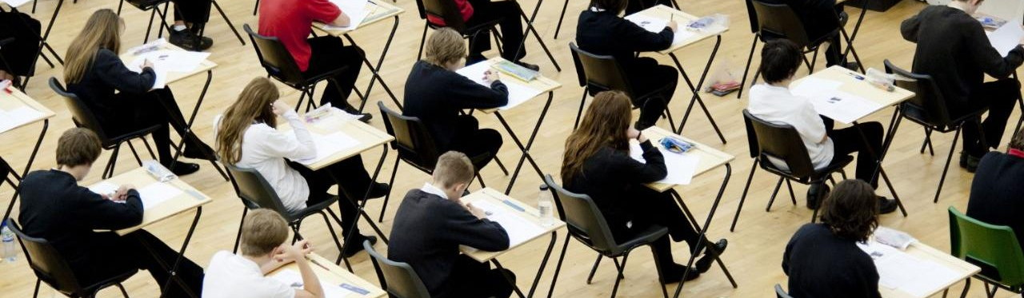
How do we test students?
Work Alone
No Internet
Closed Book
Closed Notes
High Stakes
Multiple Choice
Time Limit
One Attempt

Slide 4
Problems with paper multiple choice testing?
“Wastes so much paper.”
“Making multiple test versions is tedious.”
“Entering grades takes so long!”
“Erasure errors, key errors, version errors”
“Scantrons are expensive!”
“Hard to keep all exam copies secure”

Slide 5
We can improve on the MC exam with technology
BYOD = Bring Your Own Device
Does every student have a device?
Supplement with NAU (Cline and ELC) loaners
WiFi = Wireless Internet in the classroom
Can it handle the load?
LMS = Learning Management System
Tests in Bb Learn
e-Learning Support

Slide 6
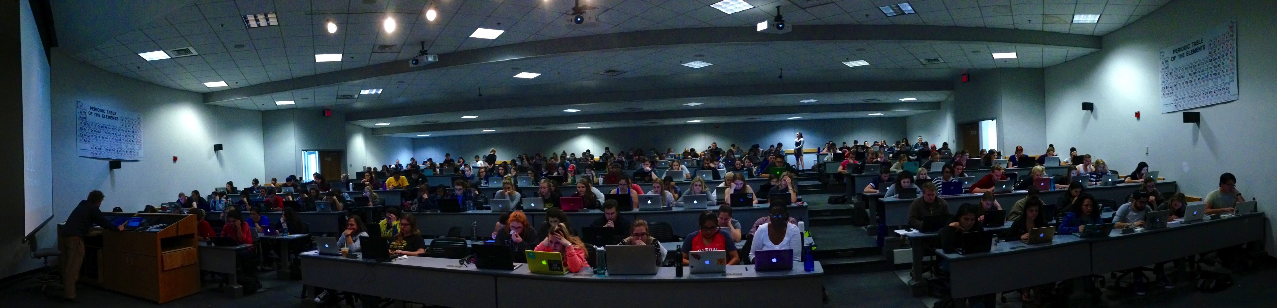
Wettaw Auditorium: 250 seats

Slide 7
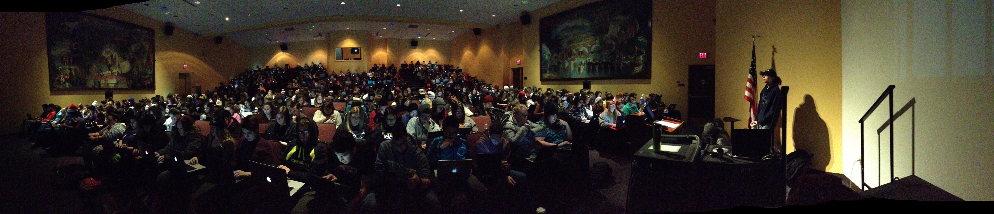
Cline Auditorium: 400 seats

Slide 8
What about cheating?
Blackboard Learn
Login required
Exam Password
Random Question Order
Random Answer Order
Large Question Pools
One Question at a time
Prevent Backtracking
!Avoid Force Completion!
What if they use Google or digital notes?
Live Proctors
View from behind
Show completion screen
Lockdown Browser*
ProctorU for remote testing
Notes:
Lockdown Browser: a good idea but not a good product in a large wireless environment.

Slide 9
“What about technology problems?”
New problems?
Old machines
Broken machines
Slow processors
Limited RAM
Viruses
Unstoppable Updates
Short Battery Life
Stubborn Background Apps
Wireless Connectivity
New ways to cheat?
ELC staff on site for tech support, with loaner laptops
A large, dedicated testing lab could fix all of these issues and more.

Slide 10
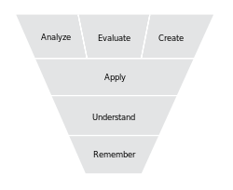
But is this good pedagogy?
What skills are we testing for with MC exams?
MC exam
What skills are we looking for in the workplace?

Slide 11
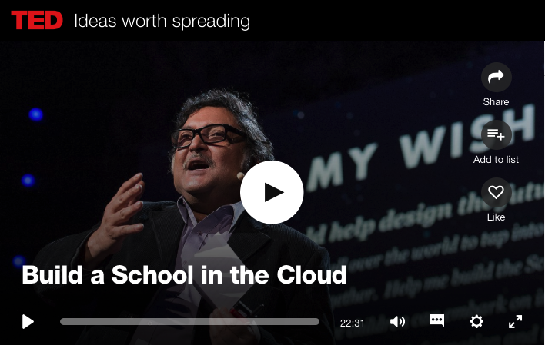
https://www.ted.com/talks/sugata_mitra_build_a_school_in_the_cloud
Watch from 00:00:00 to 00:02:40
Notes:
Play from beginning to time 00:02:41

Slide 12
Can we design our teaching to focus on these skills?
Aren’t the creative and analytical skills what we really want?

Slide 13
QUESTIONS & DISCUSSION

